Slide 1
Use case
Best trap (prospect) to drill based on reservoir potential, trap consistency and migration-accummulation potential

Slide 2
SCENARIO 1
Evaluation of hydrocarbon migration-accumulation inside each trap, assuming perfect reservoir rock
(has good lateral continuity, porosity and permeability) and perfect seal rock (using RL).
What we know:
R2 is the reservoir rock (sandstone) (RR).
R3 is the Source rock (SR) and top seal (shale).
R1 is the lateral seal(shale).
Source Rock has generated and expulsed hydrocarbons.
Traps are fault-dependent.
Migration (secondary) directly from the SR into the RR and then laterally through the RR (fill-spill migration).
What we do not know:
If the faults F1, F2, F3 and F4 are sealing or non-sealing.
Question to answer:
What are the traps in which hydrocarbons will accumulate
by changing sealing capacity of the faults.
Trap4
F3
R1
F2
Trap3
F4
F1
Trap2
Trap1
SR

Slide 3
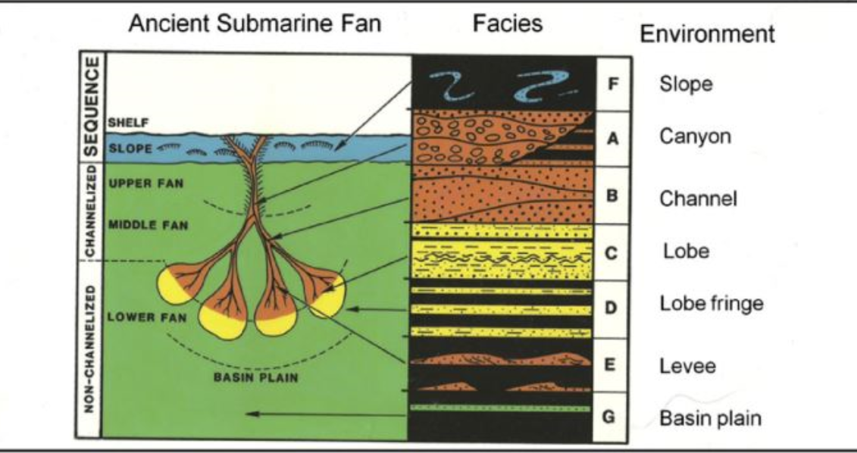
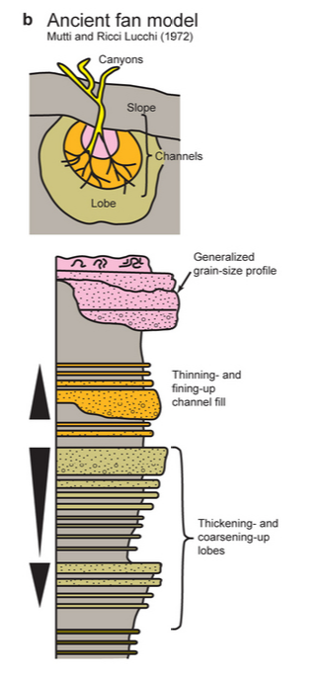
STEP 2
Evaluation of the reservoir distribution and quality assuming depositional environment Submarine Fan (using FOL and ontology).
Proximal
Distal
(after Mutti and Ricci Lucchi, 1072)

Slide 4
Middle fan;
Channels and
overbank
Distal
Proximal
Trap4
Lobe
R1
F3
Lower fan:
Trap3
F4
F2
F1
Trap2
Lobe fringe
Trap1

Slide 5
Submarine fan
Describing the components of the submarine fan system and facies specific (from proximal to distal)
  Upper fan
    Feder channel(s)
  Middle fan
  Distributary channels and interchannel settings
  Lower fan
    Lobe complexes
  Basin plain
    hemipelagites
Facies characterizarion from reservoir quality point of view (qualitative evaluation and comparison) :
    Porosity
    Permeability
    Lateral continuity
    Vertical conectivity
      Examples:
        Good porosity inside the lobe
        Porosity increases from proximal to distal; permeability decreases form proximal to distal.
How reservoir distribution (inside the depositional system) and quality can affect the migration-accumulation process inside a trap – connection with the RL

Slide 6
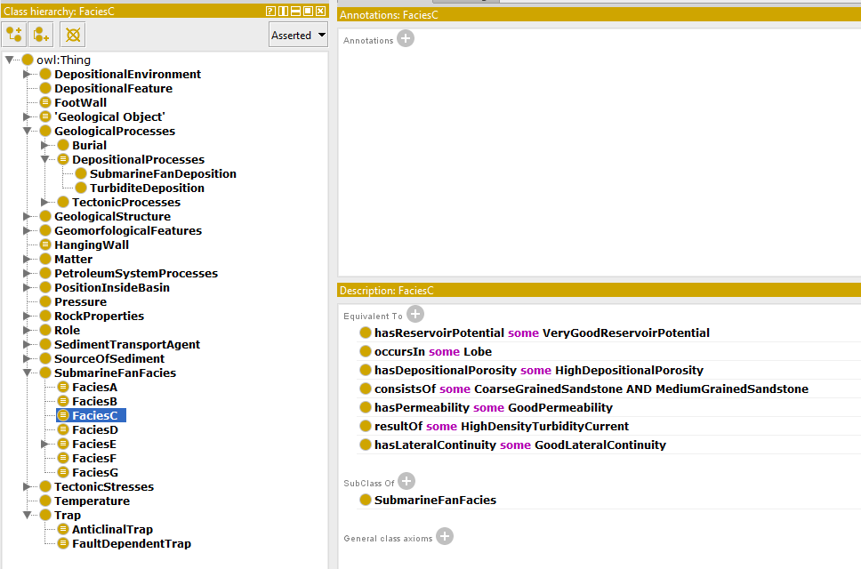
Facies characterization using ontology (example)

Slide 7
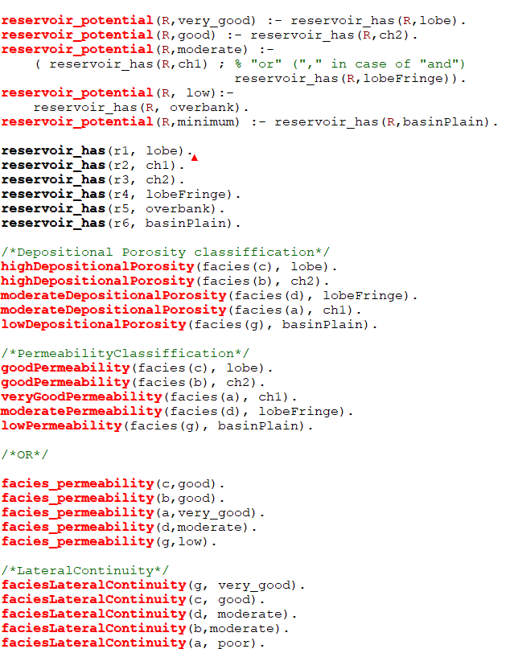
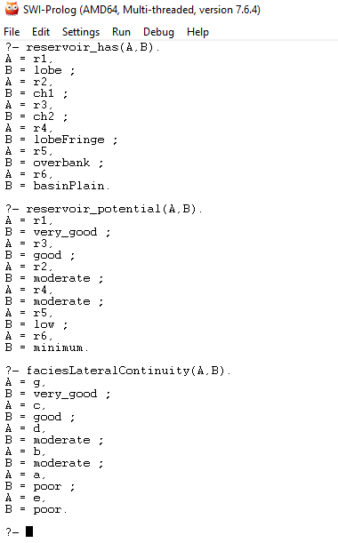
Facies characterization using FOL (example)

Slide 8
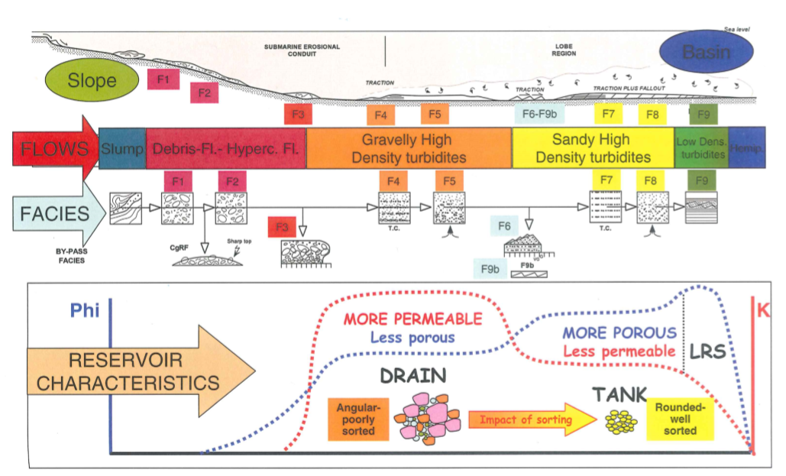
Mutti’s facies classification and reservoir potential

Slide 9
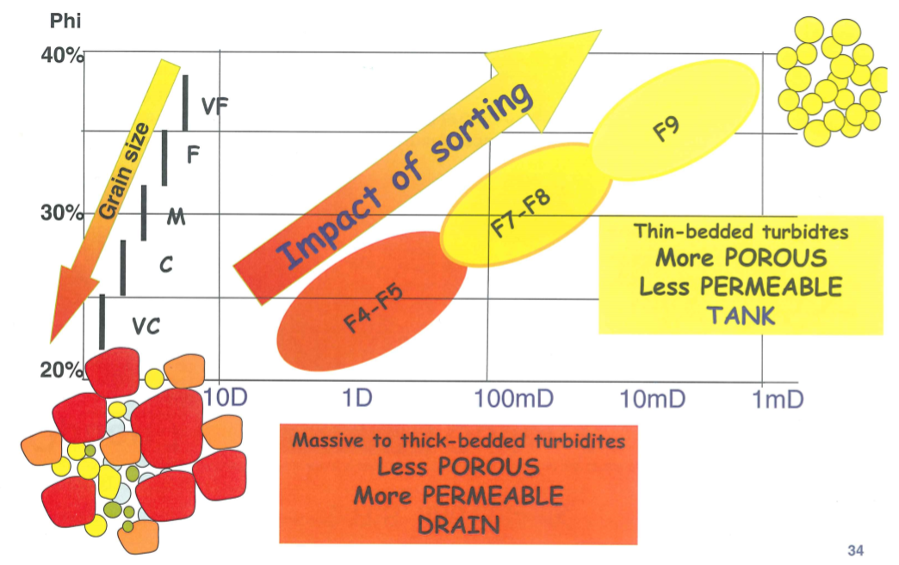
Mutti’s facies classification and reservoir potential

